Slide 1


I-CARE
Integrate Customers And Revitalize Employees
Presented by the Los Angeles District

Slide 2
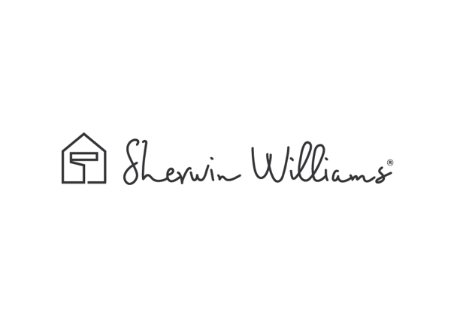
Table of Contents
Introductions
Mission Statement
Project benefits
Project Implementations
Employees
  BBQ event
  Cross Training
  Ongoing Training
Customers
  Increase Awareness
  Timeline
  DIY Grand Opening
  Contractor Pro Show

Slide 3
Introduction
Intern Group Members
Sarah Farmer UCLA (University of California, Los Angeles)
Ruth Ramos CSULA (California State University of Los Angeles)
Daniel Kim CSULB (California State University of Long Beach)
Jonathan Javier UCR (University of California, Riverside)
Opportunity
Substantial opportunity for DIY sales & company growth
When Kwal was converted into Sherwin-Williams, their DIY sales during the month of June one year later went up from $318,638.75 to $496,065.09 (over a 50% increase)
According to The Global Consulting Partnership;
People, culture, and leadership will be the game makers or breakers of the acquisition
Profitability is about performance, but performance is about the people—one person at a time and collectively.
Notes:
I-CARE will address all of these areas.

Slide 4
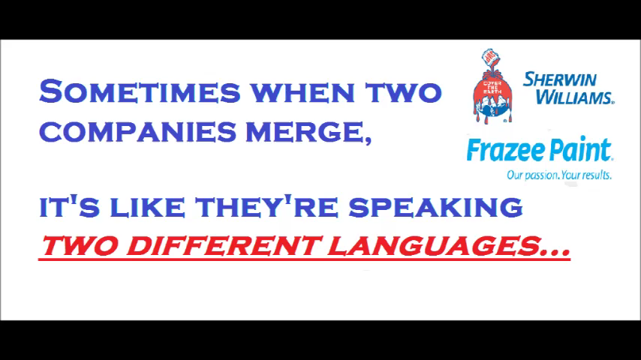

Slide 5

Mission Statement
Our goal is to transition the Frazee stores into Sherwin-Williams stores in the most efficient and smoothest way possible by integrating customers and revitalizing employees through a multi-step business plan, which we organized after conducting field observations and research.

Slide 6

Project Benefits
Increase our customer market
Maximize company profits
Smooth and efficient transition
Strengthen employee relations
Potential reuse for future acquisitions

Slide 7
Project Implementation
Team Building
Awareness
Proper Training
Increase
Sales
Our goal is to implement this plan in Frazee stores so we can maximize our company’s potential, and possibly use it for future company transitions as well.
Notes:
team building 2. awareness 3. proper training

Slide 8
Employee Team Building
Family Fun Weekend BBQ
Frazee and Sherwin-Williams employees will get to bond, build friendships, address cultural differences, and network
DETAILS
Hosted by The Women’s Resource Group and high potential leaders for each zone (both Sherwin-Williams and Frazee)
Two weekends per Zone in order to allow stores to be staffed
Event from 10:00 am - 1:00 pm
Costs to consider: employee pay (paid mandatory event), location, food, event materials (t-shirts)

Slide 9
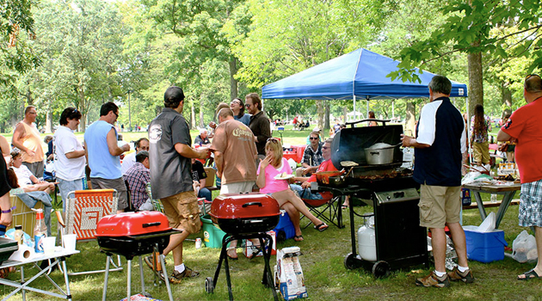
The prime time to have this event would be in either October or early November in order to avoid the holidays and ensure the event happens early on in the transition.

Slide 10

Family Fun Weekend
10:00- 11:30
Team building activities: SW & Frazee employees will be placed in groups based off of the buddy store system, then individuals within that group will be partnered together by the hosts
Activities include: ice breakers, an obstacle course, & games
Families can cheer on employees during obstacle course
The winners will receive free lunch for two
11:30- 1:00pm
Bbq starts & families can mingle

Slide 11
Event Zones
Events will be divided among the mapped out zones
The exception would be stores 8287, 8661, and 8679 since their zones do not include a Frazee. They would instead merge with stores 1534, 8199, 8243, and 8678 for the event due to their zone being the closest in proximity for employees.
Total number of events: 9
Why is it important?
  Builds employee relations=company growth+increased profits
  Gives a chance to break down cultural barriers
  Opportunity for leaders in our company to step up and take part in the change

Slide 12


Notes:
Need music here

Slide 13
Cross Training
Frazee employees will SW employees will be
be transferred to their transferred to their
partner SW store respective Frazee store
Store and assistant managers will be visiting for a full day shift
Full time and part time employees will be placed at their designated store for one week (half one week, other half the next week)
  This allows time to learn about the different cultures, as well as gain product knowledge
Notes:
Frazee management would also need to meet with a SW Training Store Manager to learn about our different company training approaches before the cross training

Slide 14
Cross Training
The purpose is to familiarize Frazee employees to SW products, excel in customer service, and understand the culture
Proposed Date: 2 weeks before the conversion
Benefits:
SW employees will increase the demand for SW products at the Frazee stores
Frazee employees feel more included within the company
Gain a better understanding of what to expect at their transitioned store
Will grow stronger relationships

Slide 15
Management Cross Training
Frazee management will meet with a SW Training Store Manager. The purpose:
to learn about SW training approaches and expectations before the cross training
to build on both company strengths and weaknesses
to better understand both cultures and values
to build a plan on how to best work with one another during the training sessions

Slide 16
Product Knowledge Workbook
Begin: 4 weeks prior to transition
End: on the last day of their crossover training (vary)
Structure will be similar to that of an MTP & Intern workbook
Include:
Product description features & application
Recommended primer, temperature, roller/ brush
Activities: where employees will get to roll out the paint in order to have a first hand experience of what differentiates the different kinds of products
Notes:
We came up with this idea after speaking to Eric who started off at Frazee and was placed at a SW store. He mentioned that the area he had the most difficulty with was product knowlede.
This was something that he had not realized he needed so much imporvement on until he was placed at a SW.
He highly encouraged Frazee employees to have the opportunity to do the crossover training before the transition in order to learn as much & as quickly as possible.

Slide 17
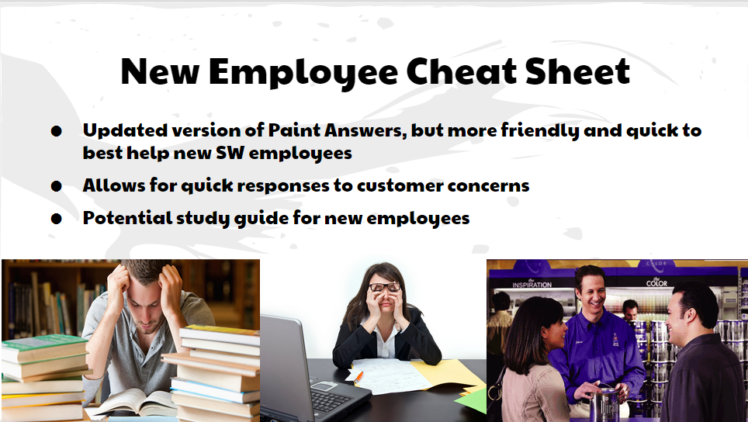

Slide 18
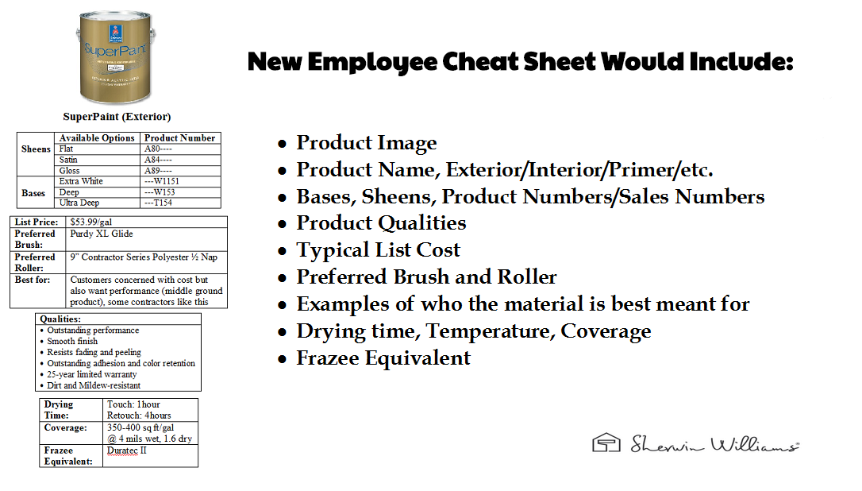

Slide 19
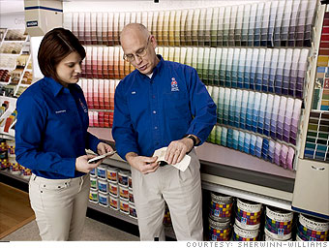
Customers
For our customers, we want to ensure that the conversion from Frazee to Sherwin-Williams is as smooth and informative as possible. The key to this is to spread awareness and help ease their worries by providing as much information as possible. We can achieve both of these doing the following:
Increase awareness before the
crossover
DIY Grand Opening
Contractor Pro Show

Slide 20
Why is this so important?
We found that the Kwal stores lost a lot of customers and potential sales due to lack of awareness and information.
The Global Consulting Partnership, along with other successful companies like Google and Apple, stress the importance of good communication and awareness throughout a company’s acquisition and transition.
To do this, we need to reduce employee tension, increase customer satisfaction. and maximize profits

Slide 21


Increase Awareness
Notice and promote the transition one month prior
Emails to customers should be sent, flyers should be created and made available in Frazee stores, and Frazee employees should call their loyal Frazee customers (sales calls) to tell them about the transition.
Frazee stores should also start stacking shelves with Sherwin-Williams products and provide recommendations to start transitioning as soon as possible.

Slide 22
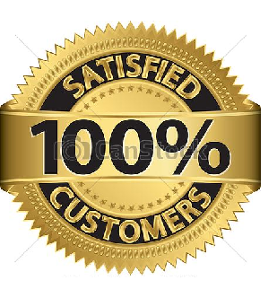
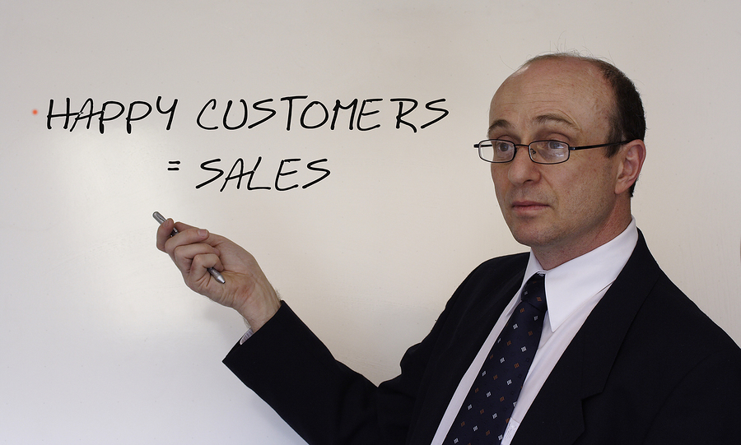
Increase Awareness (continued)
Cards and brochures that are DIY friendly should be made for customers for reference.
These cards/brochures should resemble the New Employee Cheat Sheet and compare SW products to their frazee equivalent(s).

Slide 23


Timelines
A final way to help increase awareness and guide employees, customers, and management would be to create a timeline that outlines when changes will occur.
A specific timeline would be given to employees and customers before the transition to ensure complete awareness.
Dates would be store specific based off of conversion dates and be distributed in the store for employees at least two weeks ahead of the training crossover, and distributed to customers one month prior to the transition.

Slide 24
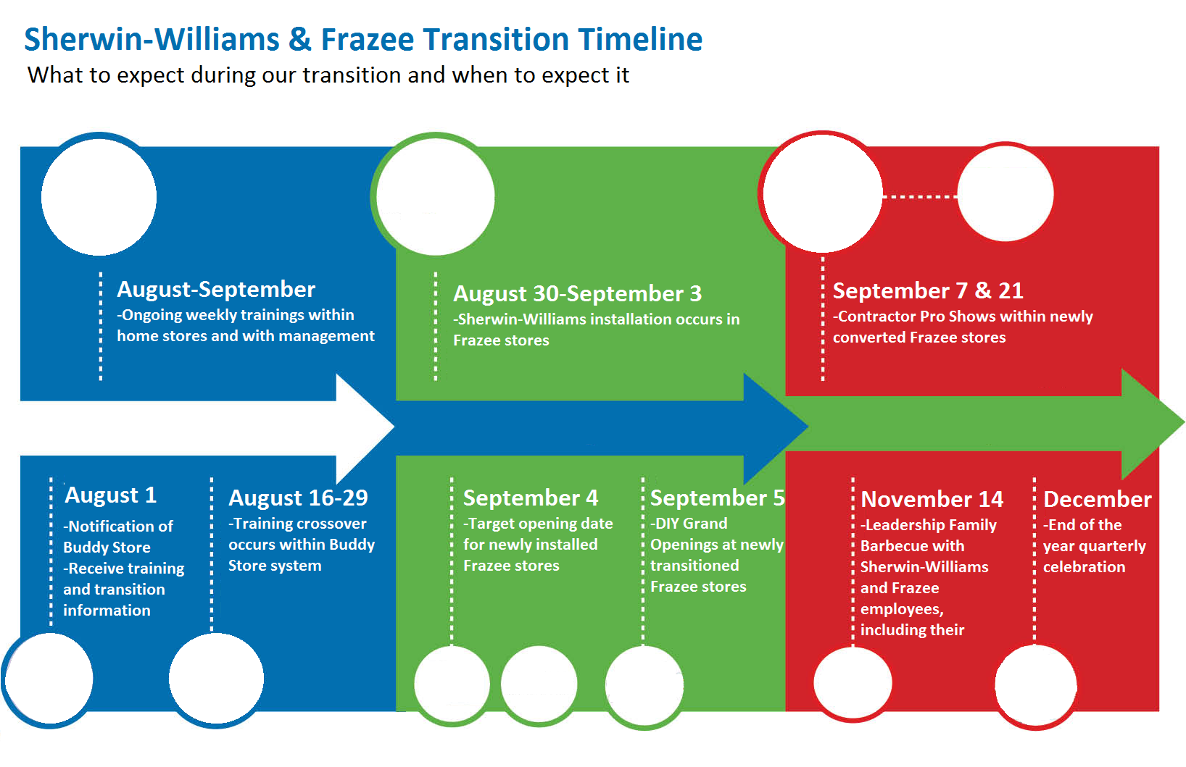
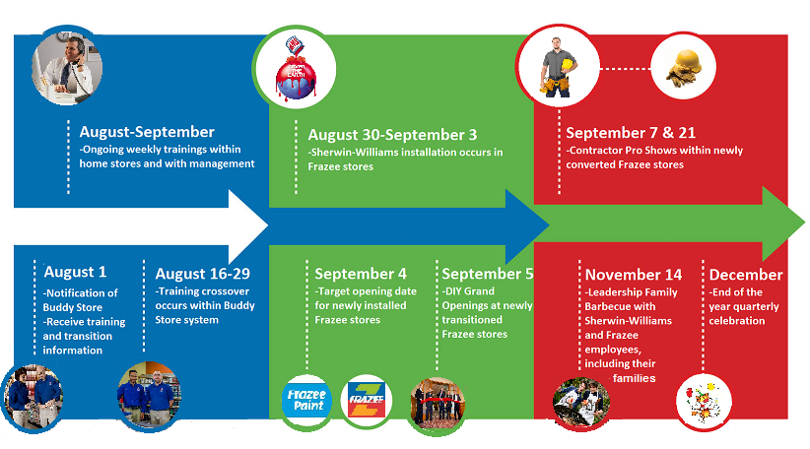
Timeline
Notes:
Anaheim store example. Notification of buddy store and training information given two weeks before training cross over (The blue would be employee specific), September 5th is the saturday after opening to best attract DIYS, Pro Shows are the tuesday following the opening and two weeks after that to best accommodate contractors, the leadership event is set for a saturday to best accommodate families and religious practices--it’s in november to best accommodate holidays and is after the major portion of the transition for most stores in the zone.

Slide 25

DIY Grand Opening
The goal is to attract more DIY customers and increase sales.
On a saturday after the major transition
Free food (taco trucks), entertainment (clowns, music), free fandex, raffles.

Slide 26

Contractor Pro Show
Twice a month during the first month of transition
On a Tuesday or Wednesday after the transition
Big sale for contractors (showcase best products)
This will allow contractors to try out the SW paints, and once they roll out SW products, it will become their preferred brand & increase sales
Notes:
These pro shows will allow contractors to try out SW products &

Slide 27

Why Choose I-CARE?

Slide 28

Top 5 Reasons Why Customers Don’t Return
Employees are not knowledgeable/properly trained
Poor customer service
Employees/stores made mistakes
Prices are the focus rather than overall value (too high)
Store lacks organization/readiness
I-CARE helps address ALL these issues through proper training, team building, and customer and employee awareness. And it’s fast, efficient, and embraces Sherwin-Williams values.
Notes:
Successfully integrate the Frazee employees into the SW team
Smoothly transition old Frazee customers to SW

Slide 29
Moreover...
I-CARE addresses the cultural barriers that will play a key role in the success of the transition.
“The primary reason many mergers and acquisitions do not deliver longer-term value is because they lack a strong cultural-integration plan. Leaders fail to realize integrating cultures is not a short-term task and does not happen immediately.
Two cultures must be brought together and blended to create a collaborative, high-performance new company. The strengths of both must be captured and capitalized on.”--The Global Consulting Partnership
Urgency not HASTE = most successful transitions
Notes:
Break any cultural barriers between these two companies and increase sales

Slide 30


Slide 31



Conclusion
We hope that our ideas will be implemented in the future to maintain a strong bond between Sherwin-Williams and Frazee, and ultimately ease the transitioning process for our valuable sister company.

Slide 32

Notes:
All of us say we are the best in another language.Break any cultural barriers between these two companies and increase sales

